Slide 1


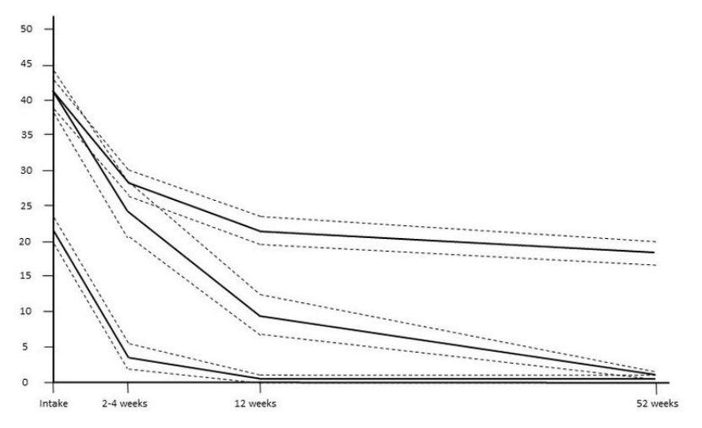

SYdBIOME: SYstematic Merging of BIOlogy, Mental health, & Environment
James M Elliott, Andrew Baillie, Jade Barclay, Aaron Beach, Anna Boucher, Samantha Jakimowicz, John Magnussen, Paul M.Middleton, Trudy Rebbeck, Rita Shackel, Debra Shirley, Leanne Togher, Dave Walton
Recovery after musculoskeletal (MSK) trauma is highly variable and appears to have little to no association with the actual parameters of the injurious event itself. As a result, it makes sense to instead explore the detailed differences between people who experience the trauma, in an effort to identify those unique prognostic variables that could become new targets for precision (and compassionate) rehabilitation.
Post-trauma distress (TIDS score) was partially predicted by pre-existing comorbidities, lower educational attainment, and Adverse Childhood Experiences, collectively explaining 13.8% of variance in distress. Development of new mediating and moderating analyses of gene x blood x environment interactions hold promise as potential targets for precision interventions to facilitate recovery.
Background
Results
To date, data from the SYMBIOME study (N = 235) have resulted in new findings describing recovery trajectories, and predictors thereof, in so far 7 peer-reviewed publications with several more under review or preparation. Several findings include:
Derivation of a 3-trajectory model (Fig. 1) for recovery regardless of body region injured: a rapid recovery group (recovered) (34.9%), another (mild) with higher baseline and delayed recovery (19.2%), and a third (severe) with persistently high disability / chronic pain (45.9%).
The TIDS was able to significantly discriminate between future trajectories with ≥76% accuracy (>90% accuracy for identifying the rapid recovery group from the other two).
Identification of at least 29 potentially meaningful biomarker-by-prior status interaction effects in explaining significant variance in acute pain scores. A latent profile analysis (LPA) of 8 plasma markers (chosen for their prior associations with pain or stress) revealed a 3-cluster solution that fit the data. The smallest class, representing 18.9% of the sample, was defined by high [BDNF] and [TGFβ1] for which pain scores were significantly higher compared to the other two classes (‘average’ and ‘low’ marker groups).
Derivation of cut scores and prognostic accuracy for two new prognostic self-report tools. Those reporting greater childhood adversities appraised the recent trauma as more threatening (via the Brief Illness Perceptions Questionnaire²), and reported higher functional interference. Further, the association between threat appraisal and interference was partially mediated by post-traumatic distress, measured by the TIDS. This model explained 57.1% of variance in interference scores. Additionally, the pathway between childhood adversity and threat appraisal was significant only in males but not females.
The association between pre-trauma life stressors and post-trauma acute pain severity was mediated by the effect of life stress on disturbed sleep and disturbed sleep on pain.
severe
% Functional Interference
Aim
mild
We aim to:
1) Identify and validate trajectories of recovery after trauma.
2) Develop data-driven biological and social prognostic phenotypes and use those to explore integrated models of pain and recovery.
recovered
Weeks since injury
Fig. 1: Recovery trajectories found with latent growth curve analysis of a mixed sample of n = 235 participants.
Methods
The SYMBIOME longitudinal cohort study (SYstematic Merging of BIOlogy, Mental health, and Environment) was a collaborative observational study in Canada and the United States in which adults >18 years were recruited from urgent or emergency care centres after acute MSK trauma, provided rich biopsychosocial data, and were followed for 12 months to map baseline data onto recovery trajectories. Data included demographics (age, sex, region of injury), biological (blood, saliva, hair, stool), psychological (post-trauma distress, depression, pain and disability), and social (socioeconomic status, gender roles, prior life stress). To measure distress, we developed the Traumatic Injuries Distress Scale (TIDS)¹ a brief 12-item patient-reported screening tool that can predict poor outcomes regardless of the region of bodily injury.
All variables have since been assayed and evaluated for hundreds of data points on each participant.
Conclusions
No person encounters MSK trauma in a vacuum, rather new research must integrate data from across the breadth of human experience to build and test models that will provide more meaningful and accurate estimations of recovery outcomes and identify personalised targets for risk mitigation where necessary. Larger samples and big data-based analytics are the next logical step. Here we propose SYdBIOME, a multidisciplinary and multi-institutional collaborative expansion of the SYMBIOME, based in Australia.
¹ Walton et al. JOSPT. 2016 46(10):920-928
² Broadbent et al., J Psychosom Res. 2006 Jun;60(6):631-7
References

